Slide 1
Section 3 heat exchangers analysis

Slide 2
Outline
Process flow diagram
Analysis
Expected results

Slide 3
Process flow diagram

Slide 4
PFD explanation
Based on above PFD
Deterioration in performance of E-357 and E-358 directly increases load of E-359 (thermic fluid preheater)
Similarly deterioration in performance of E-351, E-352 & E-353 directly increase load of E-354 (LP steam heater), however in case even after 100% opening of steam supply valve, enough temperature not achieve then this load also transfers to thermic fluid preheater

Slide 5
E-357 Analysis
 |  | Design data |  |  | 8-Jun-16 |  |  | 10-Jun-16
E-357 | Spiral | Cold Side | Hot Side |  | Cold Side | Hot Side |  | Cold Side | Hot Side
Fluid |  | FA | FA |  | FA | FA |  | FA | FA
Flow | Kg/hr | 30000 | 18200 |  | 22000 | 13650 |  | 21700 | 13086
Temp (in) | °C | 123.3 | 176 |  | 97.4 | 164.5 |  | 102.5 | 168.4
Temp (out) | °C | 153.4 | 128.6 |  | 125.1 | 114.8 |  | 130.9 | 116
Cp | Kcal/Kg°C | 0.6 | 0.6 |  | 0.6 | 0.6 |  | 0.6 | 0.6
Heat Load | Kcal/hr | 491728 | 517608 |  | 366339 | 407043 |  | 370281 | 411424
LMTD | °C | 12 |  |  | 27 |  |  | 24
Area | m2 | 174.00 |  |  | 174.00 |  |  | 174.00
HTC | Kcal/hrm2°C | 237 |  |  | 78 |  |  | 90
 | W/m2K | 275 |  |  | 91 |  |  | 105

Slide 6
E-357 Analysis contd.
 |  | After cleaning
E-357 | Spiral | Cold Side | Hot Side
Fluid |  | FA | FA
Flow | Kg/hr | 22000 | 13650
Temp (in) | °C | 97.4 | 164.5
Temp (out) | °C | 132.7 | 104.5
Cp | Kcal/Kg°C | 0.6 | 0.6
Heat Load | Kcal/hr | 466830 | 491400
LMTD | °C | 16
Area | m2 | 174.00
HTC | Kcal/hrm2°C | 163
 | W/m2K | 189
Rise in feed temperature = 7.6 °C
Extra heat recovered = 0.12 Mkcal/hr
Cost saving = 12.1 Lacs Rs/year

Slide 7
E-358 Analysis
 |  | Design data |  |  | 8-Jun-16 |  |  | 10-Jun-16
E-358 | Spiral | Cold Side | Hot Side |  | Cold Side | Hot Side |  | Cold Side | Hot Side
Fluid |  | FA | FA |  | FA | FA |  | FA | FA
Flow | Kg/hr | 30000 | 9800 |  | 22000 | 6200 |  | 21700 | 4865
Temp (in) | °C | 149.2 | 257 |  | 125.1 | 225.1 |  | 130.9 | 220.6
Temp (out) | °C | 179.9 | 165 |  | 139.4 | 168.7 |  | 142.1 | 165.1
Cp | Kcal/Kg°C | 0.6 | 0.6 |  | 0.6 | 0.6 |  | 0.6 | 0.6
Heat Load | Kcal/hr | 513912 | 540960 |  | 188827 | 209808 |  | 145804 | 162005
LMTD | °C | 39 |  |  | 62 |  |  | 53
Area | m2 | 45.30 |  |  | 45.30 |  |  | 45.30
HTC | Kcal/hrm2°C | 293 |  |  | 67 |  |  | 60
 | W/m2K | 341 |  |  | 78 |  |  | 70

Slide 8
E-358 analysis contd.
 |  | After cleaning
E-358 | Spiral | Cold Side | Hot Side
Fluid |  | FA | FA
Flow | Kg/hr | 22000 | 6200
Temp (in) | °C | 132.7 | 225.1
Temp (out) | °C | 154.7 | 143
Cp | Kcal/Kg°C | 0.6 | 0.6
Heat Load | Kcal/hr | 290141 | 305412
LMTD | °C | 31
Area | m2 | 45.30
HTC | Kcal/hrm2°C | 205
 | W/m2K | 238
Rise in feed temperature = 7.4 °C
Extra heat recovered = 0.11 Mkcal/hr
Cost saving = 11.8 Lacs Rs/year

Slide 9
Expected results from cleaning
E-358 outlet temperature before cleaning = 139.4°C
E-358 outlet temperature after cleaning = 154.7 °C (Calculated)
Rise in feed temperature = 15.3 °C
Energy saving = 0.24 Mkcal/hr
Cost saving = 24.4 Lacs Rs/year
(@5 Rs coal cost and 300 days running)

Slide 10
Other benefits
Improvement in heat recovery will also reduce heat load of cooling towers
Similar results are expected from section 4 & 5 heat exchanger network (Data to be collected)
Way forward

Slide 11
Section 4 heat exchangers analysis

Slide 12
Taken for Study
E – 426 – Not in operation
E – 427 – analysis done
E – 406 – Data inconsistent. TT to be checked
E – 429 – Not in operation
E – 435 – analysis done

Slide 13
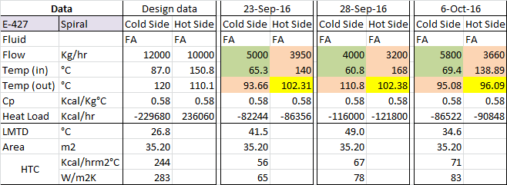
E - 427 data & analysis
Analysis: Design HTC = 244 Kcal/hrm2°C
Actual HTC = 56 – 71 Kcal/hrm2°C
Supposed HTC for above feed rate = 121 – 136 Kcal/hrm2°C

Slide 14
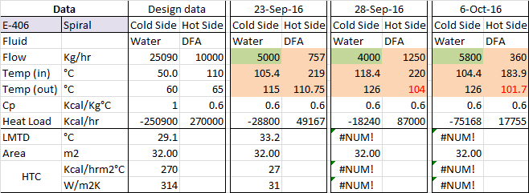
E - 406 data & analysis
Analysis: Hot side outlet temperature is below cold side inlet temperature,
Which indicate any one of these TT is malfunctioning

Slide 15
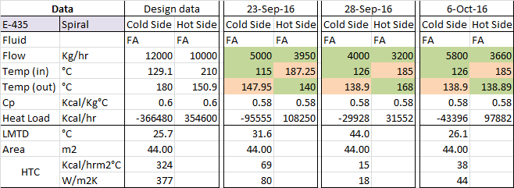
E - 435 data & analysis
Analysis: Design HTC = 324 Kcal/hrm2°C
Actual HTC = 15 - 69 Kcal/hrm2°C
Supposed HTC for above feed rate = 160 - 181 Kcal/hrm2°C

Slide 16
Section 5 heat exchangers analysis

Slide 17
Taken for study
E – 102 – Insufficient data. TT not available
E – 105 – Insufficient data. TT not available
E – 402 – analysis based on approach temp
E – 104 – Data inconsistent. TT to be checked
E – 101 – analysis based on approach temp

Slide 18
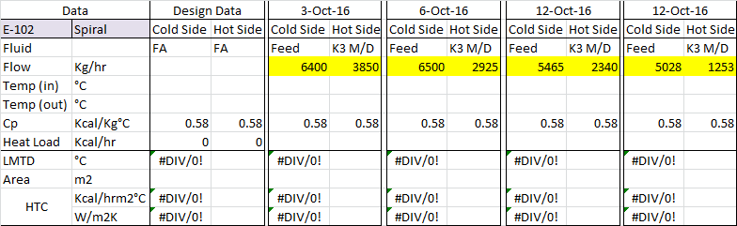
E - 102 data & analysis
Analysis: Data insufficient

Slide 19
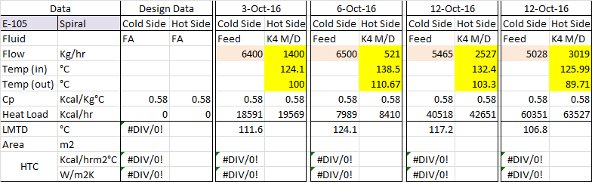
E - 105 data & analysis
Analysis: Data insufficient

Slide 20
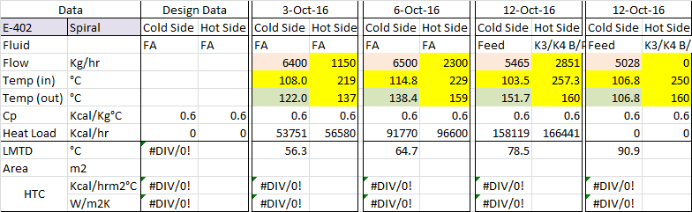
E - 402 data & analysis
Analysis: Design data not available.
Approach temperature value for above data are 29, 44, 56, 53
Approach temperature value is on higher side, for a properly design spiral
heat exchanger, this value usually lies in range of 5 to 15 °C

Slide 21
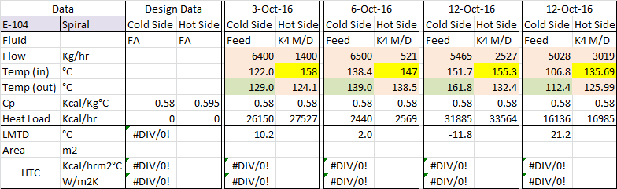
E - 104 data & analysis
Analysis: Hot side outlet temperature is below cold side inlet temperature in one case
and very less difference in other cases. This indicate any one of these TT is malfunctioning

Slide 22
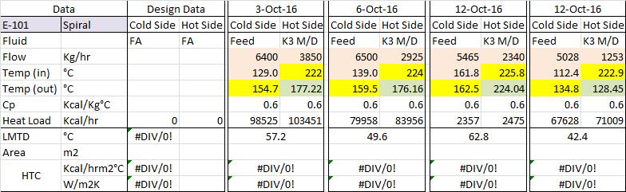
E - 101 data & analysis
Analysis: Design data not available.
Approach temperature value for above data are 48, 37, 62, 16
Approach temperature value is on higher side, for a properly design spiral
heat exchanger, this value usually lies in range of 5 to 15 °C

Slide 23
Thank You !!!

